Slide 1



CSE 2213:
Discrete Mathematics
Modified Slides (based on the source mentioned below):
Originals slides by Dr. Baek and Dr. Still, adapted by J. Stelovsky
Based on slides Dr. M. P. Frank and Dr. J.L. Gross
Provided by McGraw-Hill
1-1

Slide 2

Lecture 02
Chapter 1. The Foundations
1.1 Propositional Logic

Slide 3


Review:
The Implication Operator
The conditional statement (a.k.a. implication)
p → q states that p implies q.
I.e., If p is true, then q is true; but if p is not true, then q could be either true or false.
E.g., let p = “You study hard.”
q = “You will get a good grade.”
p → q = “If you study hard, then you will
get a good grade.” (else, it could go either way)
p: hypothesis or antecedent or premise
q: conclusion or consequence

Slide 4

Review:
Implication Truth Table
p q
p→q
T T T
T F F
F T T
F F T
The only False case!
p → q is false only when p is true but q is not true.
p → q does not require that p or q are ever true!
E.g. “(1=0) → cows can fly” is TRUE!

Slide 5

Examples of Implications
“If this lecture ever ends, then the sun will rise
tomorrow.” True or False?
(T → T)
“If 1+1=6, then Dhaka is a city.”
True or False?
(F → T)
“If the moon is made of green cheese, then I am richer than Bill Gates.” True or False? (F → F)
“If Tuesday is a day of the week, then I am a
penguin.” True or False?
(T → F)

Slide 6
English Phrases Meaning p → q
“p implies q”
“if p, then q”
“if p, q”
“when p, q”
“whenever p, q”
“q if p”
“q when p”
“q whenever p”
“p only if q”
“p is sufficient for q”
“q is necessary for p”
“q follows from p”
“q is implied by p”
We will see some equivalent logic expressions later.

Slide 7




Converse, Inverse, Contrapositive
Some terminology, for an implication p → q:
Its converse is:
Its inverse is:
Its contrapositive:
q → p.
¬p → ¬q.
¬q → ¬p.
¬p →¬q
p q
p→q q→p
¬q →¬p
T T T
T F F
F T T
F F T
T T F T
T T F T
T F T T
One of these three has the same meaning (same truth table) as p → q. Can you figure out which?

Slide 8

Examples
p: Today is ‘Eid
q: Tomorrow is Monday
p → q :
If today is ‘Eid then tomorrow is Monday.
Converse: q → p
If tomorrow is Monday then today is ‘Eid.
Inverse: ¬p → ¬q
If today is not ‘Eid then tomorrow is not Monday.
Contrapositive: ¬q → ¬p
If tomorrow is not Monday then today is not ‘Eid.

Slide 9
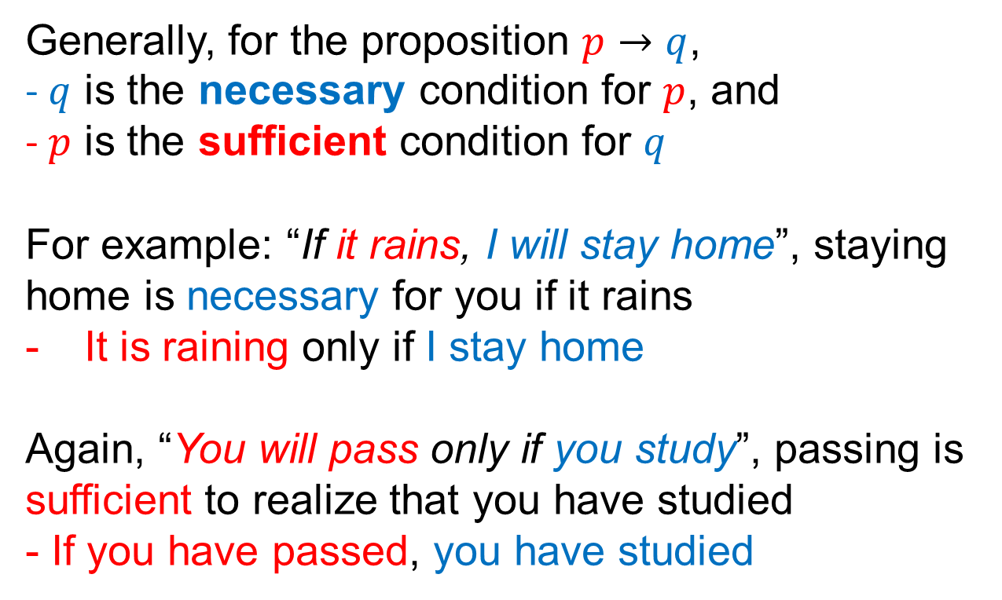
Necessary Condition and Sufficient Condition
Generally, for the proposition $p→q$,
- $q$ is the necessary condition for $p$, and
- $p$ is the sufficient condition for $q$
For example: “If it rains, I will stay home”, staying home is necessary for you if it rains
It is raining only if I stay home
Again, “You will pass only if you study”, passing is sufficient to realize that you have studied
- If you have passed, you have studied

Slide 10
The Biconditional Operator
The biconditional statement p ↔ q states that p if and only if (iff) q.
p = “It is below freezing.”
q = “It is snowing.”
p ↔ q = “It is below freezing if and only if it is snowing.”
or
= “That it is below freezing is necessary and sufficient for it to be snowing”

Slide 11
Biconditional Truth Table
p q
p ↔ q
p is necessary and sufficient for q
T T T
T F F
F T F
F F T
If p then q, and conversely
p iff q
p ↔ q is equivalent to (p → q) ∧ (q → p).
p ↔ q means that p and q have the same truth value.
p ↔ q does not imply that p and q are true.
Note this truth table is the exact opposite of ⊕’s! Thus, p ↔ q means ¬(p ⊕ q).

Slide 12
Boolean Operations Summary
Conjunction: p ∧ q, (read p and q), “discrete math is a required course and I am a computer science major”.
Disjunction: , p ∨ q, (read p or q), “discrete math is a required course or I am a computer science major”.
Exclusive or: p ⊕ q, “discrete math is a required course or I am a computer science major but not both”.
Implication: p → q, “if discrete math is a required course then I am a computer science major”.
Biconditional: p ↔ q, “discrete math is a required course if and only if I am a computer science major”.

Slide 13
Boolean Operations Summary
We have seen 1 unary operator and 5 binary operators. What are they? Their truth tables are below.
p | q | ¬p | p∧q | p∨q | p⊕q | p→q | p↔q
T | T | F | T | T | F | T | T
T | F | F | F | T | T | F | F
F | T | T | F | T | T | T | F
F | F | T | F | F | F | T | T
For an implication p → q
Its converse is:
Its inverse is:
Its contrapositive:
q → p
¬p → ¬q
¬q → ¬p
2-12

Slide 14

Compound Propositions
A propositional variable is a variable such as p, q, r (possibly subscripted, e.g. p_{j}) over the Boolean domain.
An atomic proposition is either Boolean constant or a propositional variable: e.g. T, F, p
A compound proposition is derived from atomic propositions by application of propositional operators:
e.g. ¬p, p ∨ q, (p ∨ ¬q) → q
Precedence of logical operators: ¬, ∧, ∨, →, ↔
Precedence also can be indicated by parentheses.
e.g. ¬p ∧ q means (¬p) ∧ q, not ¬(p ∧ q)

Slide 15
An Exercise
Any compound proposition can be evaluated by a truth table
(p ∨ ¬q) → q
p q ¬q
p∨¬q (p∨¬q) →q
T T
F T F T
T T F T
T F T F
T F
F T
F F

Slide 16
Translating English Sentences
Let p = “It rained last night”,
q = “The sprinklers came on last night,”
r = “The lawn was wet this morning.”
Translate each of the following into English:
¬p =
r ∧ ¬p
“It didn’t rain last night.”
= “The lawn was wet this morning, and it didn’t rain last night.”
¬r ∨ p ∨ q =
“The lawn wasn’t wet this morning, or it rained last night, or the sprinklers came on last night.”

Slide 17

Another Example
Find the converse of the following statement.
“Raining tomorrow is a sufficient condition for my not
going to town.”
Step 1: Assign propositional variables to component
propositions.
p: It will rain tomorrow
q: I will not go to town
Step 2: Symbolize the assertion: p → q
Step 3: Symbolize the converse: q → p
Step 4: Convert the symbols back into words.
“If I don’t go to town then it will rain tomorrow” or
“Raining tomorrow is a necessary condition for my not
going to town.”

Slide 18

Logic and Bit Operations
A bit is a binary (base 2) digit: 0 or 1.
Bits may be used to represent truth values.
By convention:
0 represents “False”; 1 represents “True”.
A bit string of length n is an ordered sequence of n ≥ 0 bits.
By convention, bit strings are (sometimes) written left to right:
e.g. the “first” bit of the bit string “1001101010” is 1.
What is the length of the above bit string?

Slide 19

Bitwise Operations
Boolean operations can be extended to operate on bit strings as well as single bits.
Example:
01 1011 0110
11 0001 1101
11 1011 | 1111 | Bit-wise OR
01 0001 | 0100 | Bit-wise AND
10 1010 | 1011 | Bit-wise XOR

Slide 20

End of 1.1
You have learned about:
Propositions: what they are
Propositional logic operators’
symbolic notations, truth tables, English equivalents, logical meaning
Atomic vs. compound propositions
Bits, bit strings, and bit operations
Next section:
Propositional equivalences
Equivalence laws
Proving propositional equivalences

